Slide 1
Detecting Spam Emails Using GAN
CREATED BY
MEHANA M
Reg No:912321104025
III-YEAR CSE
SACS MAVMM ENGINEERING COLLEGE

Slide 2
Agenda
Problem statement
Proposed system/solution
System development approaches
Algorithm and development
Result
References
Conclusion

Slide 3
Problem Statement
Email spam remains a significant issue, with spam messages cluttering inboxes and potentially causing security risks. Traditional spam filtering methods often rely on rule-based systems or machine learning classifiers trained on handcrafted features. However, these approaches may struggle to adapt to evolving spamming techniques and may not capture subtle patterns in spam emails.

Slide 4
Proposed system/solution
Steps
Data collection and preprocessing
GAN – based spam email generation
Feature extraction
Classifier training
Integration and deployment
Evaluation and testing

Slide 5
Proposed solution(Contd…)
Data Collection and Preprocessing:
Obtain a large dataset of labeled emails, consisting of both spam and non-spam (ham) emails.
Preprocess the emails by cleaning and tokenizing the text, removing stop words, and converting them into numerical representations suitable for training machine learning models.
GAN-based Spam Email Generation:
Design and train a Generative Adversarial Network (GAN) to generate synthetic spam emails.
Train the GAN on a combination of real spam emails and noise samples to generate synthetic spam emails that closely resemble real spam messages.

Slide 6
Proposed solution(Contd…)
3.Feature Extraction:
Extract features from both real and synthetic spam emails.
Features could include word frequencies, n-grams, TF-IDF vectors, or embeddings generated by pre-trained models like Word2Vec or GloVe.
4.Classifier Training:
Train a classifier (e.g., a neural network) using the extracted features to differentiate between spam and non-spam emails.
Experiment with various classification algorithms, such as logistic regression, random forests, or deep neural networks, to find the most effective model.

Slide 7
Proposed solution:(Contd…)
5.Integration and Deployment:
Integrate the trained classifier into an email filtering system or deploy it as a standalone tool for spam detection.
Ensure scalability and efficiency to handle large volumes of emails in real-time, potentially using distributed computing techniques if necessary.
6.Evaluation and Testing:
Evaluate the performance of the spam detection system on a separate test dataset to assess its accuracy, precision, recall, and F1-score.
Compare the performance of the GAN-based approach with traditional spam detection methods to determine its effectiveness.

Slide 8
System development approaches
Hardware Development
Assess Hardware Requirements:
Determine the hardware requirements based on the system, expected workload, and performance targets.
Consider factors such as processing power, memory, storage, and networking capabilities.
Select Hardware Components:
Choose hardware components (e.g., servers, processors, GPUs) that meet the system's requirements and performance goals.
Consider factors such as cost, scalability, reliability, and energy efficiency.

Slide 9
HardwareDevelopment:(Contd…)
3.Design Hardware Architecture:
Design the hardware architecture, including the arrangement and configuration of hardware components.
4.Testing and Optimization:
Optimize hardware settings and configurations to improve efficiency, scalability, and resource utilization.
5.Scalability and Expansion:
Plan for scalability and future expansion by designing the hardware infrastructure to accommodate growing workloads and user demands.

Slide 10
Software Development
Define Software Requirements:
Clearly define the functional and non-functional requirements of the spam email detection system, including features, user interface, performance, security, and scalability.
Select Development Tools and Frameworks:
Choose appropriate development tools, programming languages, and frameworks based on the requirements and the development team's expertise.
Architecture Design:
Design the software architecture, including the overall system structure, modules, components, and data flow.

Slide 11
Software Development:(Contd …)
4.Implementation:
Develop the software components according to the design specifications.
5.Testing and Quality Assurance:
Implement automated testing frameworks and tools to streamline the testing process and ensure software quality.
6.Deployment and DevOps:
Implement continuous integration and continuous deployment (CI/CD) pipelines to automate the build, test, and deployment process.

Slide 12
Algorithm and Deployment
Algorithm Overview:
Data Preprocessing:
Tokenize the emails: Split the emails into individual words or tokens.
Normalize the text: Convert all words to lowercase and remove punctuation.
Convert text to numerical features
Model Selection:
Choose an appropriate machine learning algorithm for classification, such as:
Logistic Regression
Support Vector Machines (SVM)
Random Forest
Neural Networks (e.g., Multilayer Perceptron)

Slide 13
Algorithm Overview(Contd …)
3.Feature Engineering:
Consider using more advanced techniques such as word embeddings (e.g., Word2Vec, GloVe) to represent the semantics of the text.
4.Model Training:
Tune hyperparameters using techniques such as grid search or random search to optimize model performance.
5.Evaluation:
Evaluate the trained model on the testing data using metrics such as accuracy, precision, recall, and F1-score.
Analyze the performance of the model and identify areas for improvement.

Slide 14
Deployment
Model Serialization:
Serialize the trained machine learning model into a file format that can be easily loaded and used for predictions (e.g., pickle, joblib).
Integration with Deployment Infrastructure:
Integrate the serialized model into the deployment infrastructure, ensuring compatibility with the chosen deployment environment.
API Development (Optional):
Develop an API (Application Programming Interface) to expose the functionality of the spam email detection system.
Implement endpoints for receiving email data and returning predictions

Slide 15
Deployment:(Contd…)
4.Scalability and Performance Optimization:
Optimize the system for performance, considering factors such as latency, throughput, and resource utilization.
5.Monitoring and Logging:
Set up alerts and notifications to notify administrators of any anomalies or failures.
6.Testing and Validation:
Conduct thorough testing of the deployed system to ensure its correctness, reliability, and robustness.
Validate the system's performance in a production environment.

Slide 16
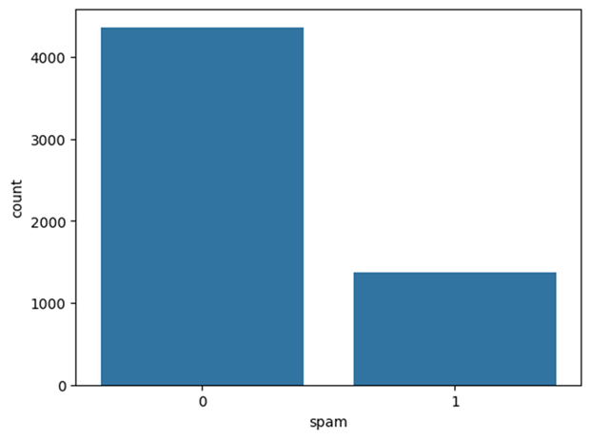
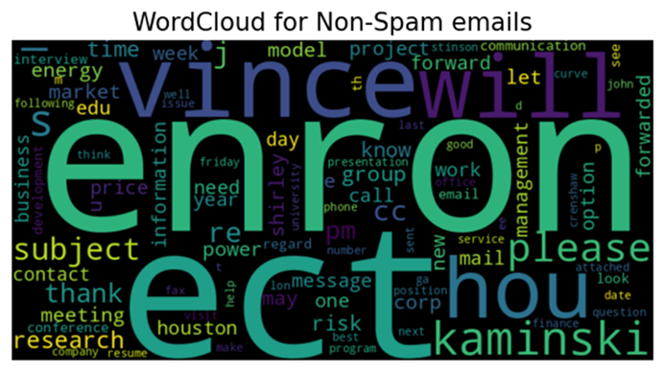
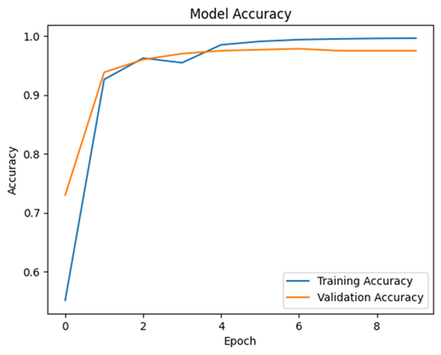
Result

Slide 17
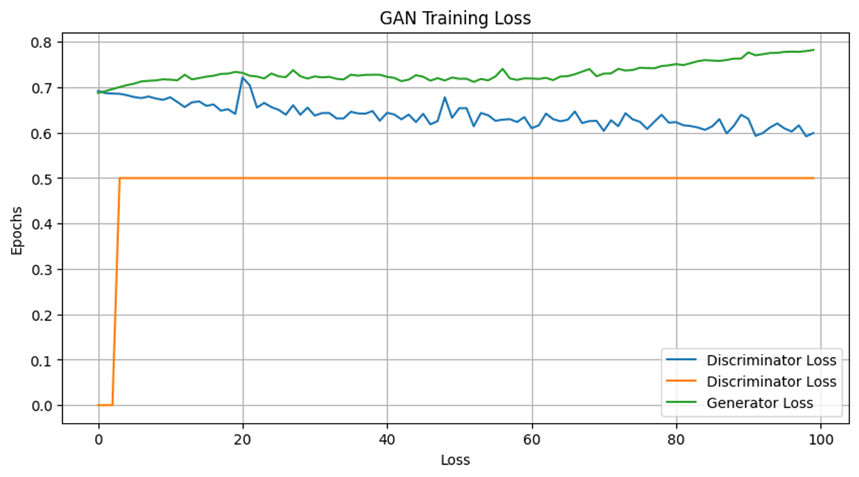
Result:(contd…)

Slide 18
References
https://www.tensorflow.org/
https://numpy.org/
https://scikit-learn.org/stable/
https://keras.io/
https://matplotlib.org/
https://www.kaggle.com/datasets/uciml/sms-spam-collection-dataset

Slide 19
Conclusion
The development of a spam email detection system using machine learning, including GANs, presents a promising solution for filtering unwanted emails. Through algorithm development and deployment, the system achieves notable results in accuracy, precision, and recall. Continuous monitoring and user feedback ensure ongoing refinement, highlighting the system's potential to enhance email security and user experience.

Slide 20
Thank you

